Slide 1
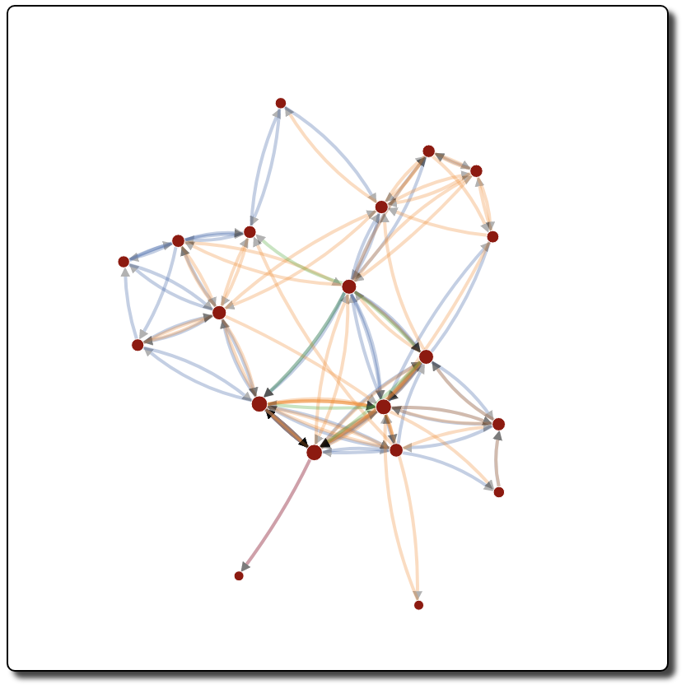
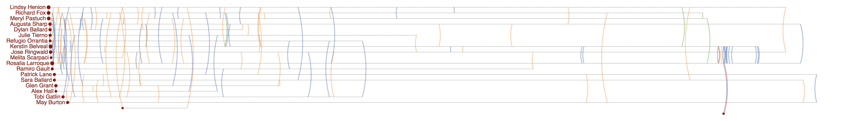
Rosalia Larroque
Rosalia Larroque
Jenice Savaria
Jenice Savaria

Slide 2
Rosalia Larroque
Rosalia Larroque
Jenice Savaria
Jenice Savaria

Slide 3
Rosalia Larroque
Rosalia Larroque
Jenice Savaria
Jenice Savaria

Slide 4
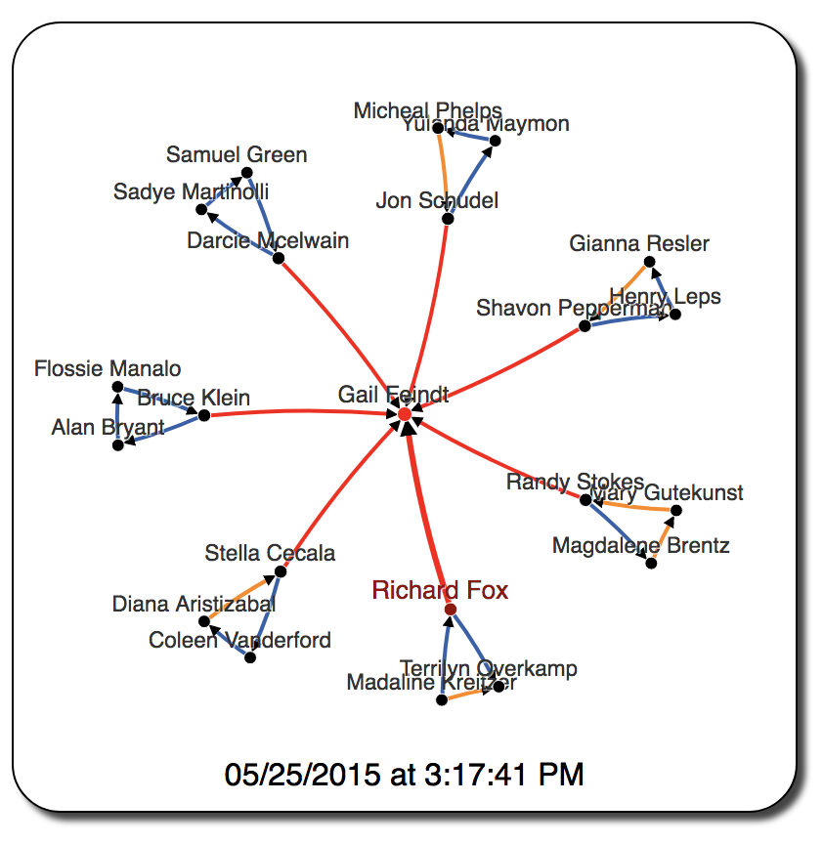
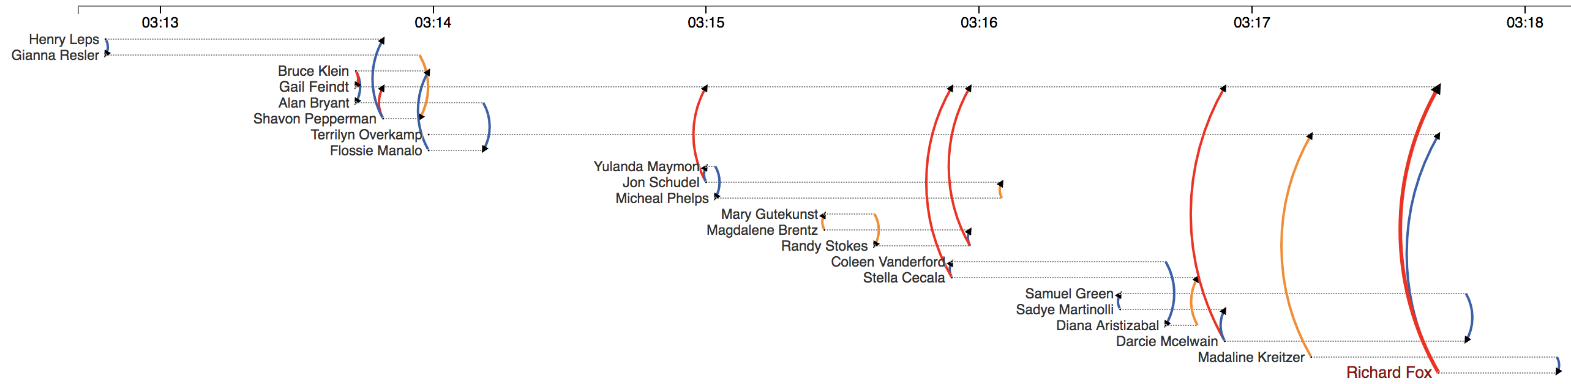

Slide 5
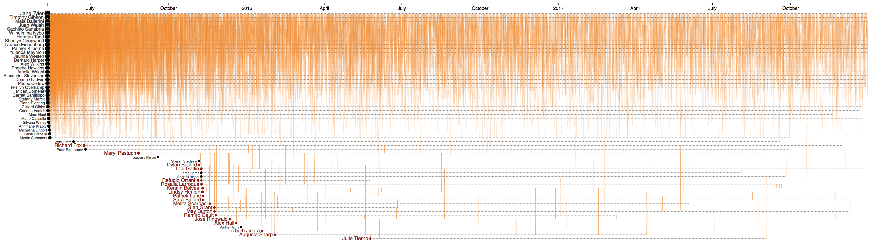
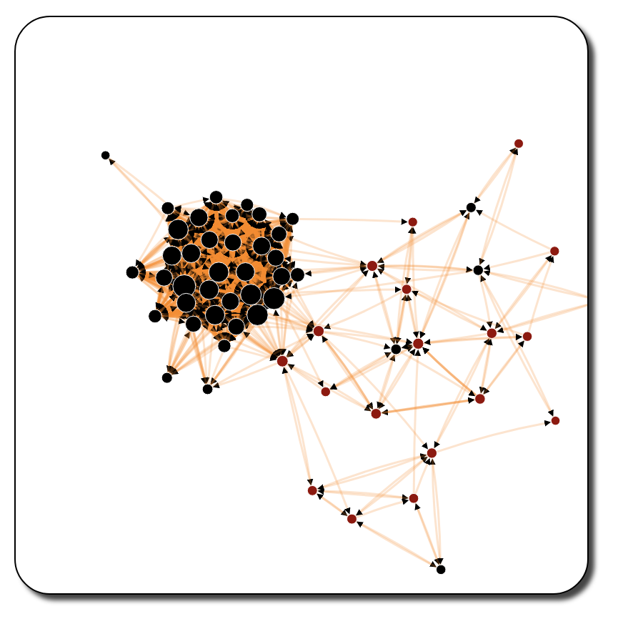
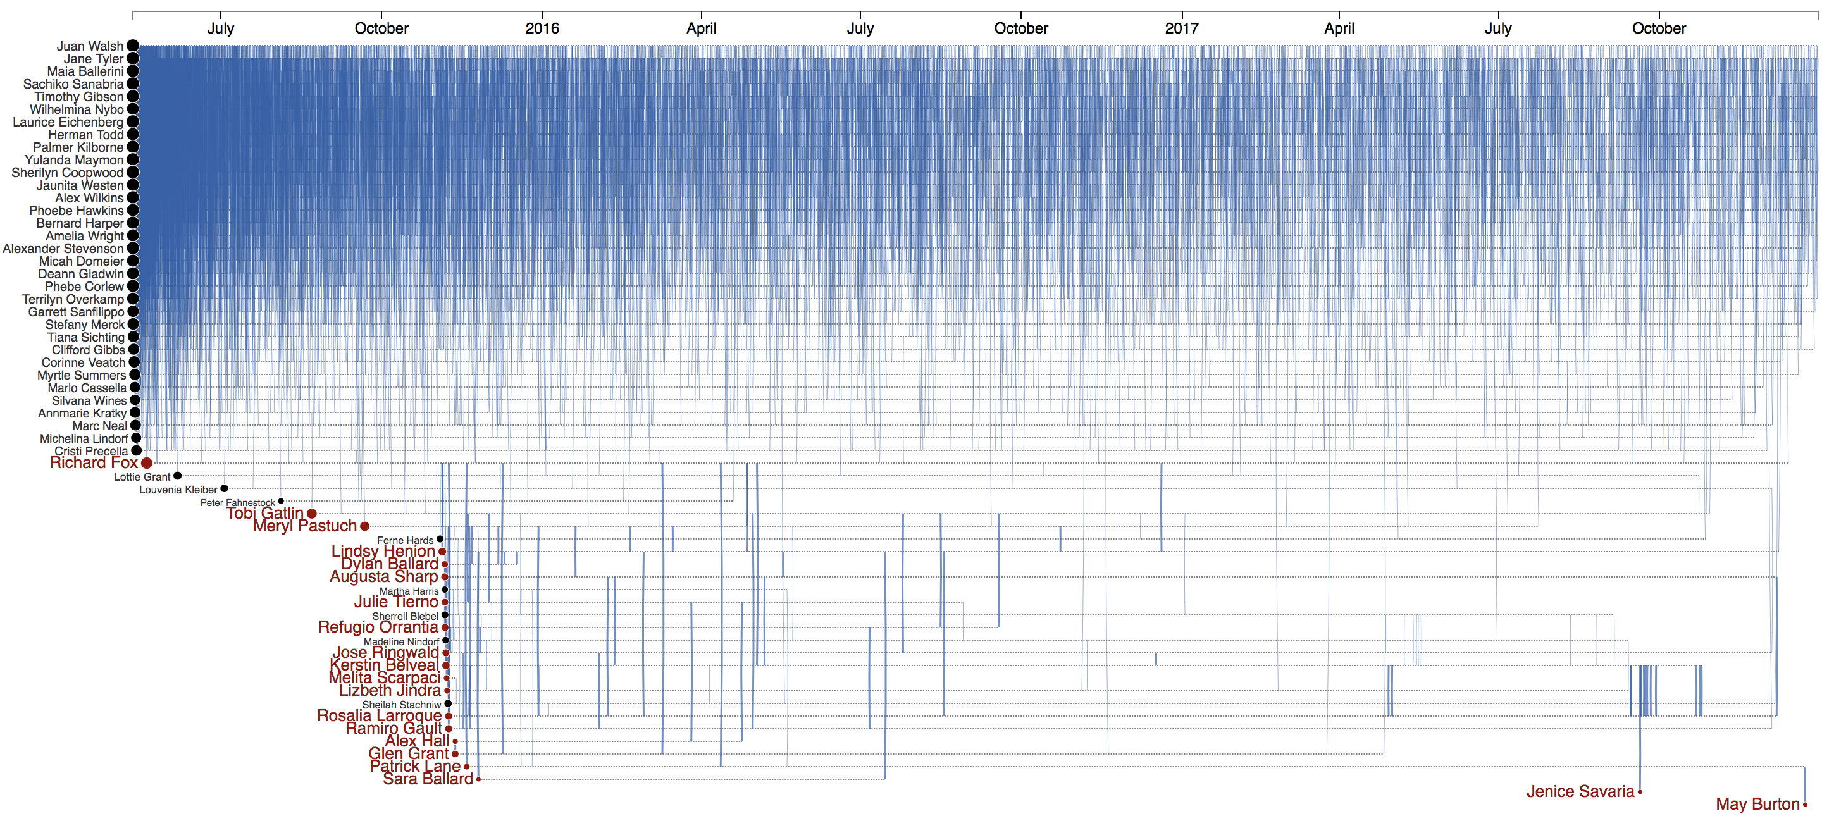
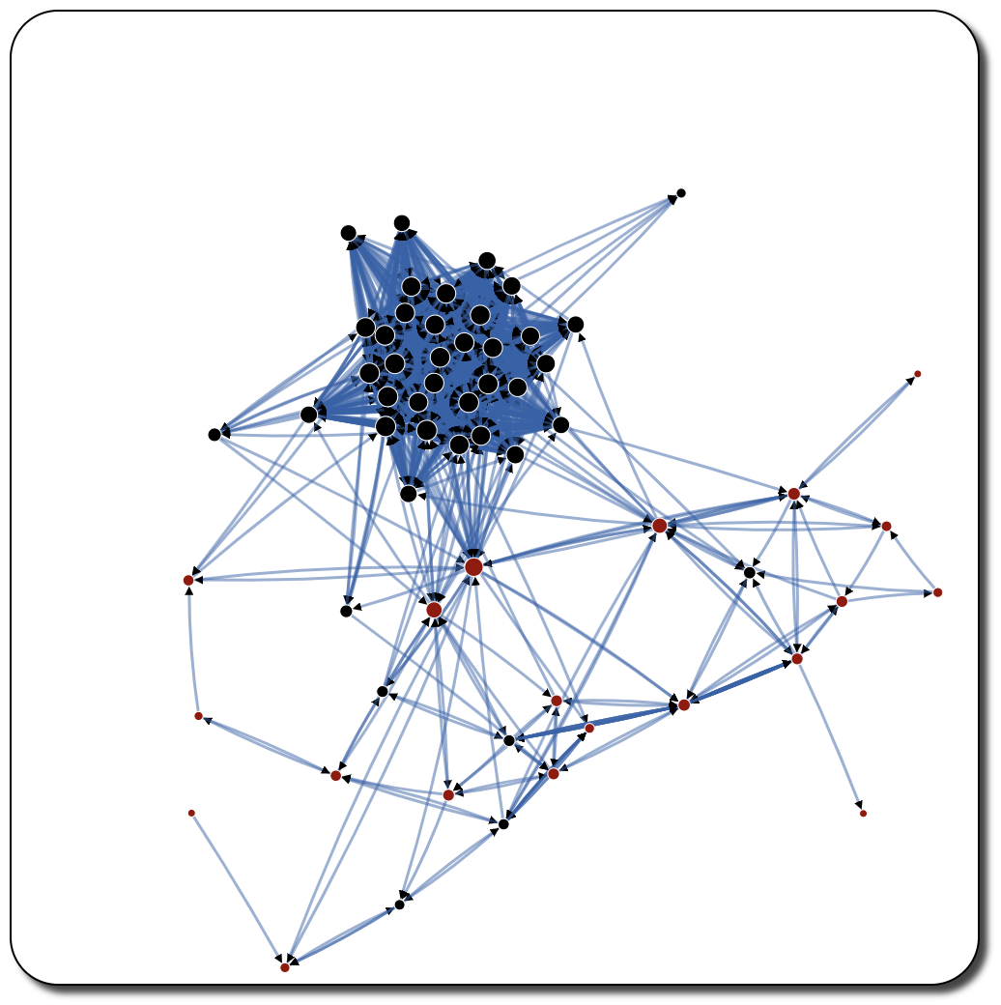

Slide 7
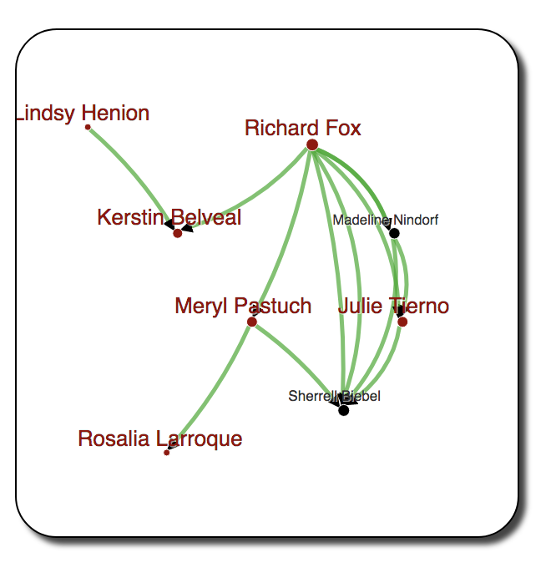
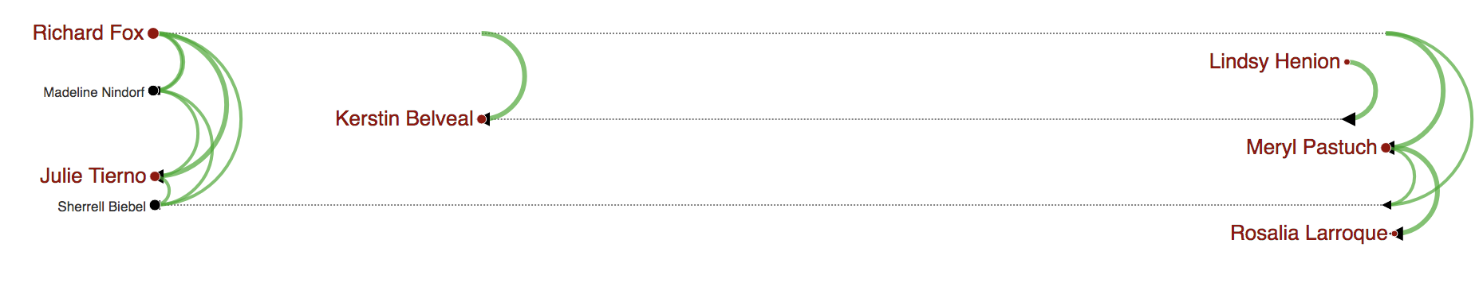
(a)
(b)
Gail Feindt

Slide 8
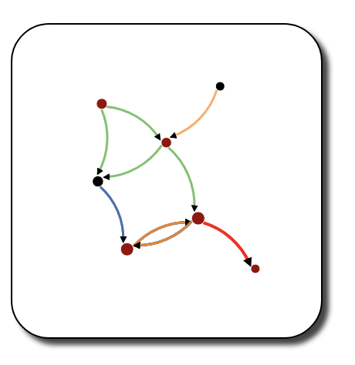
Richard Fox
Peter Fahnestock
Meryl Pastuch
Sherrell Biebel
Rosalia Larroque
Kerstin Belvea
Jenice Savaria
Jenice Savaria
(b)
(a)
Gail Feindt

Slide 9
Richard Fox
Peter Fahnestock
Meryl Pastuch
Sherrell Biebel
Rosalia Larroque
Kerstin Belvea
Jenice Savaria
Jenice Savaria

Slide 10
Richard Fox
Peter Fahnestock
Meryl Pastuch
Sherrell Biebel
Rosalia Larroque
Kerstin Belvea
Jenice Savaria
Jenice Savaria

Slide 11
Richard Fox
Meryl Pastuch
Sherrell Biebel
Jenice Savaria
Kerstin Belvea

Slide 12
Richard Fox
Meryl Pastuch
Sherrell Biebel
Rosalia Larroque
Jenice Savaria

Slide 13
Richard Fox
Meryl Pastuch
Sherrell Biebel
Jenice Savaria

Slide 14
Richard Fox
Sherrell Biebel
Jenice Savaria

Slide 15
Richard Fox
Jenice Savaria

Slide 16
Richard Fox
Jenice Savaria

Slide 17
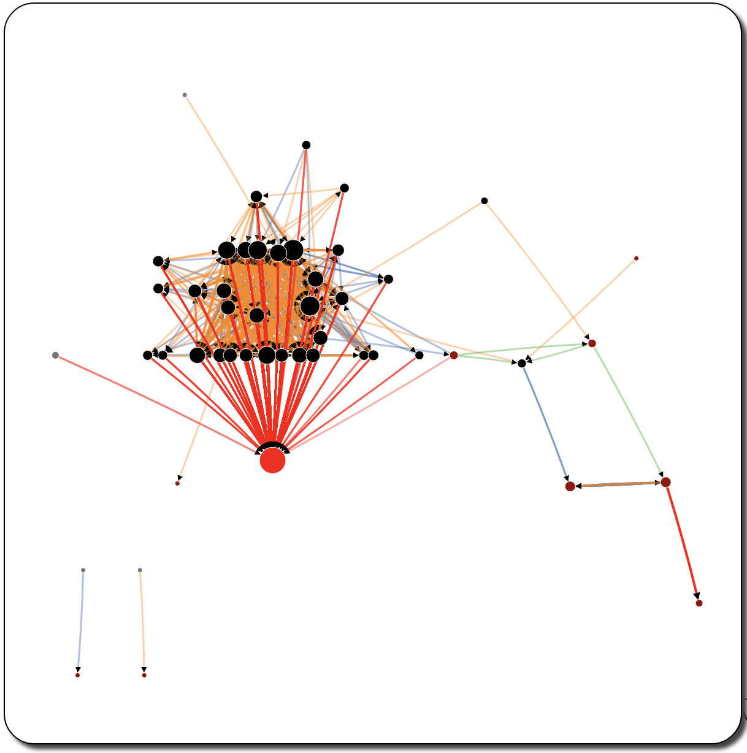
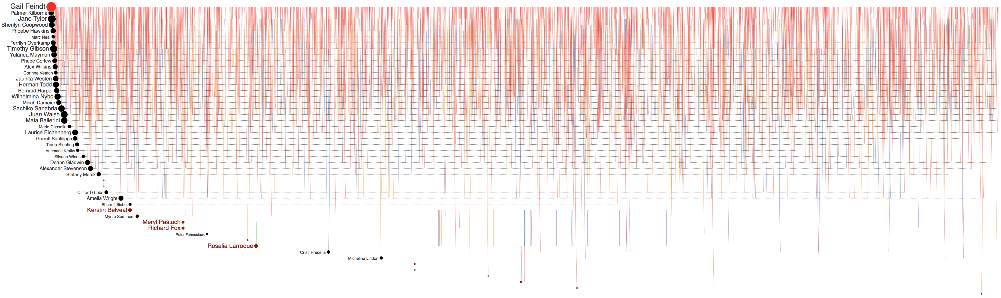
Peter Fahnestock
Meryl Pastuch
Richard Fox
Sherrell Biebel
Kerstin Belvea
Gail Feindt
Rosalia Larroque
Jenice Savaria
Rosalia Larroque
Jenice Savaria
Jenice Savaria

Slide 18
Richard Fox
Gail Feindt
Rosalia Larroque
Jenice Savaria
Rosalia Larroque
Jenice Savaria
Jenice Savaria

Slide 19
Peter Fahnestock
Meryl Pastuch
Richard Fox
Sherrell Biebel
Kerstin Belvea
Rosalia Larroque
Gail Feindt
Jenice Savaria
Jenice Savaria
Jenice Savaria

Slide 20
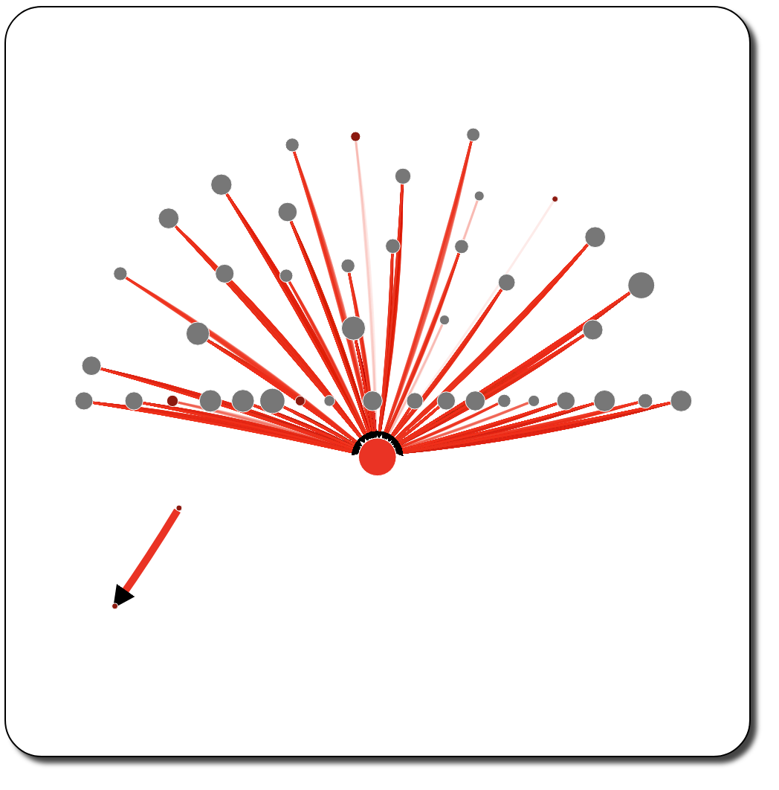
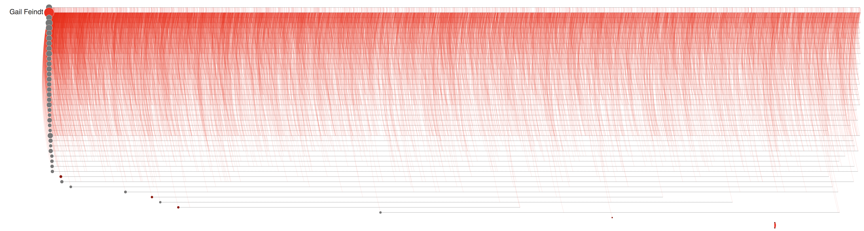


Rosalia Larroque
Jenice Savaria
(a)
(b)
Rosalia Larroque
Jenice Savaria

Slide 21
Gail Feindt
Rosalia Larroque
Jenice Savaria
Rosalia Larroque
Jenice Savaria

Slide 22
Gail Feindt
Rosalia Larroque
Rosalia Larroque
Jenice Savaria

Slide 24
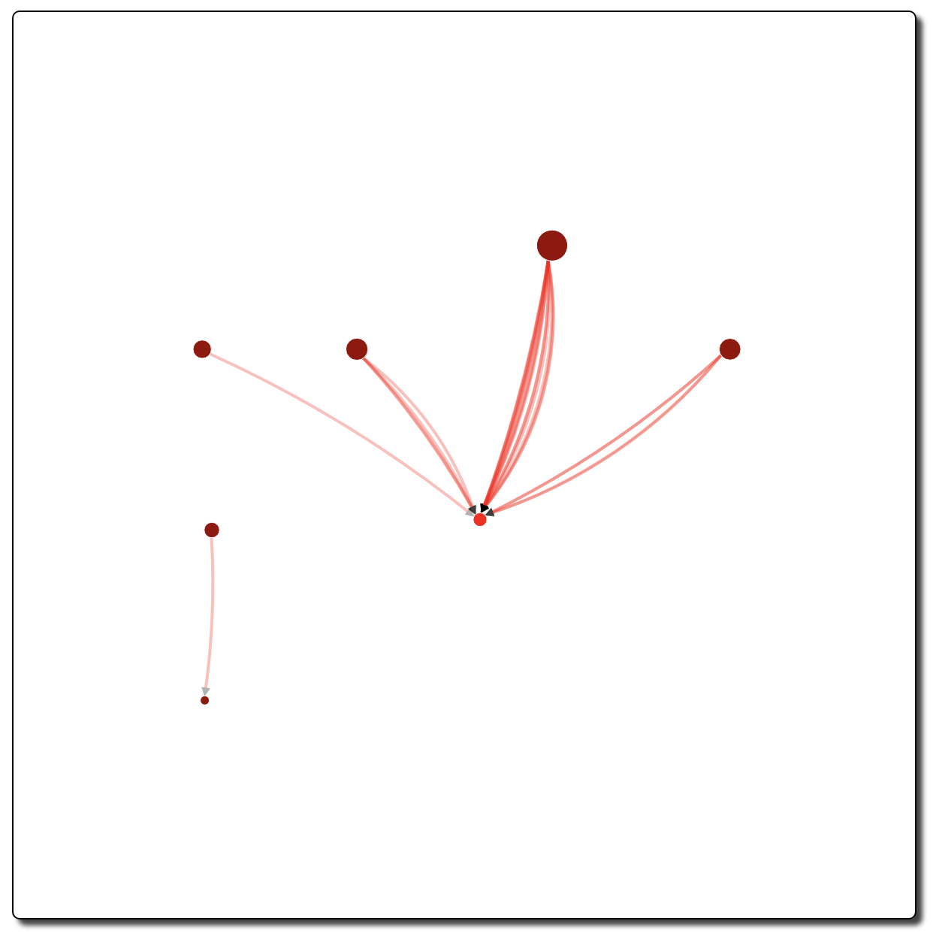
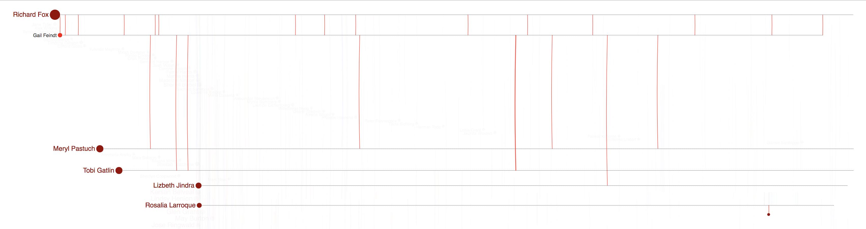
(a)
(b)

Slide 25
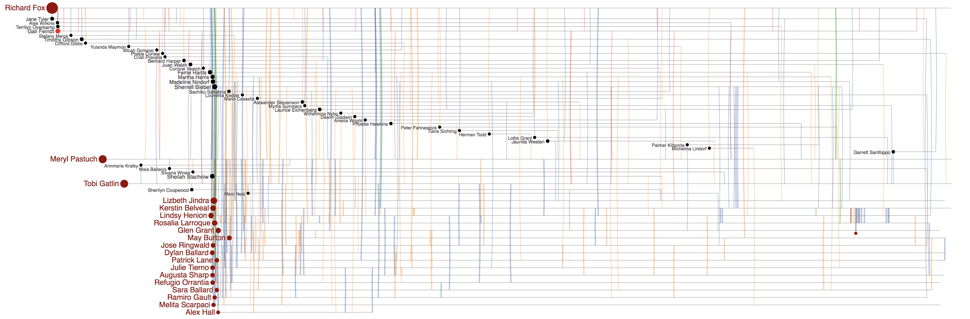
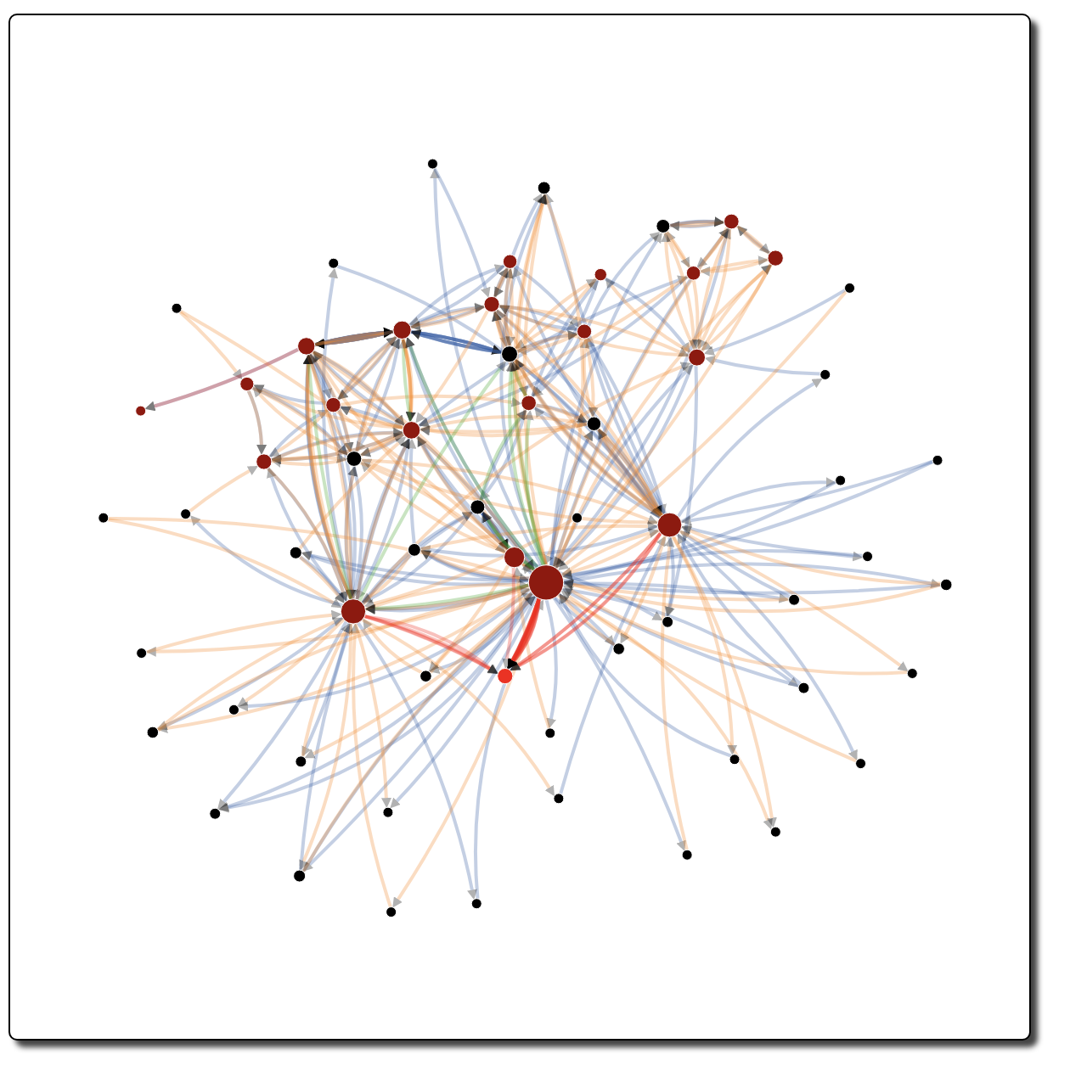
(a)
(b)

Slide 26
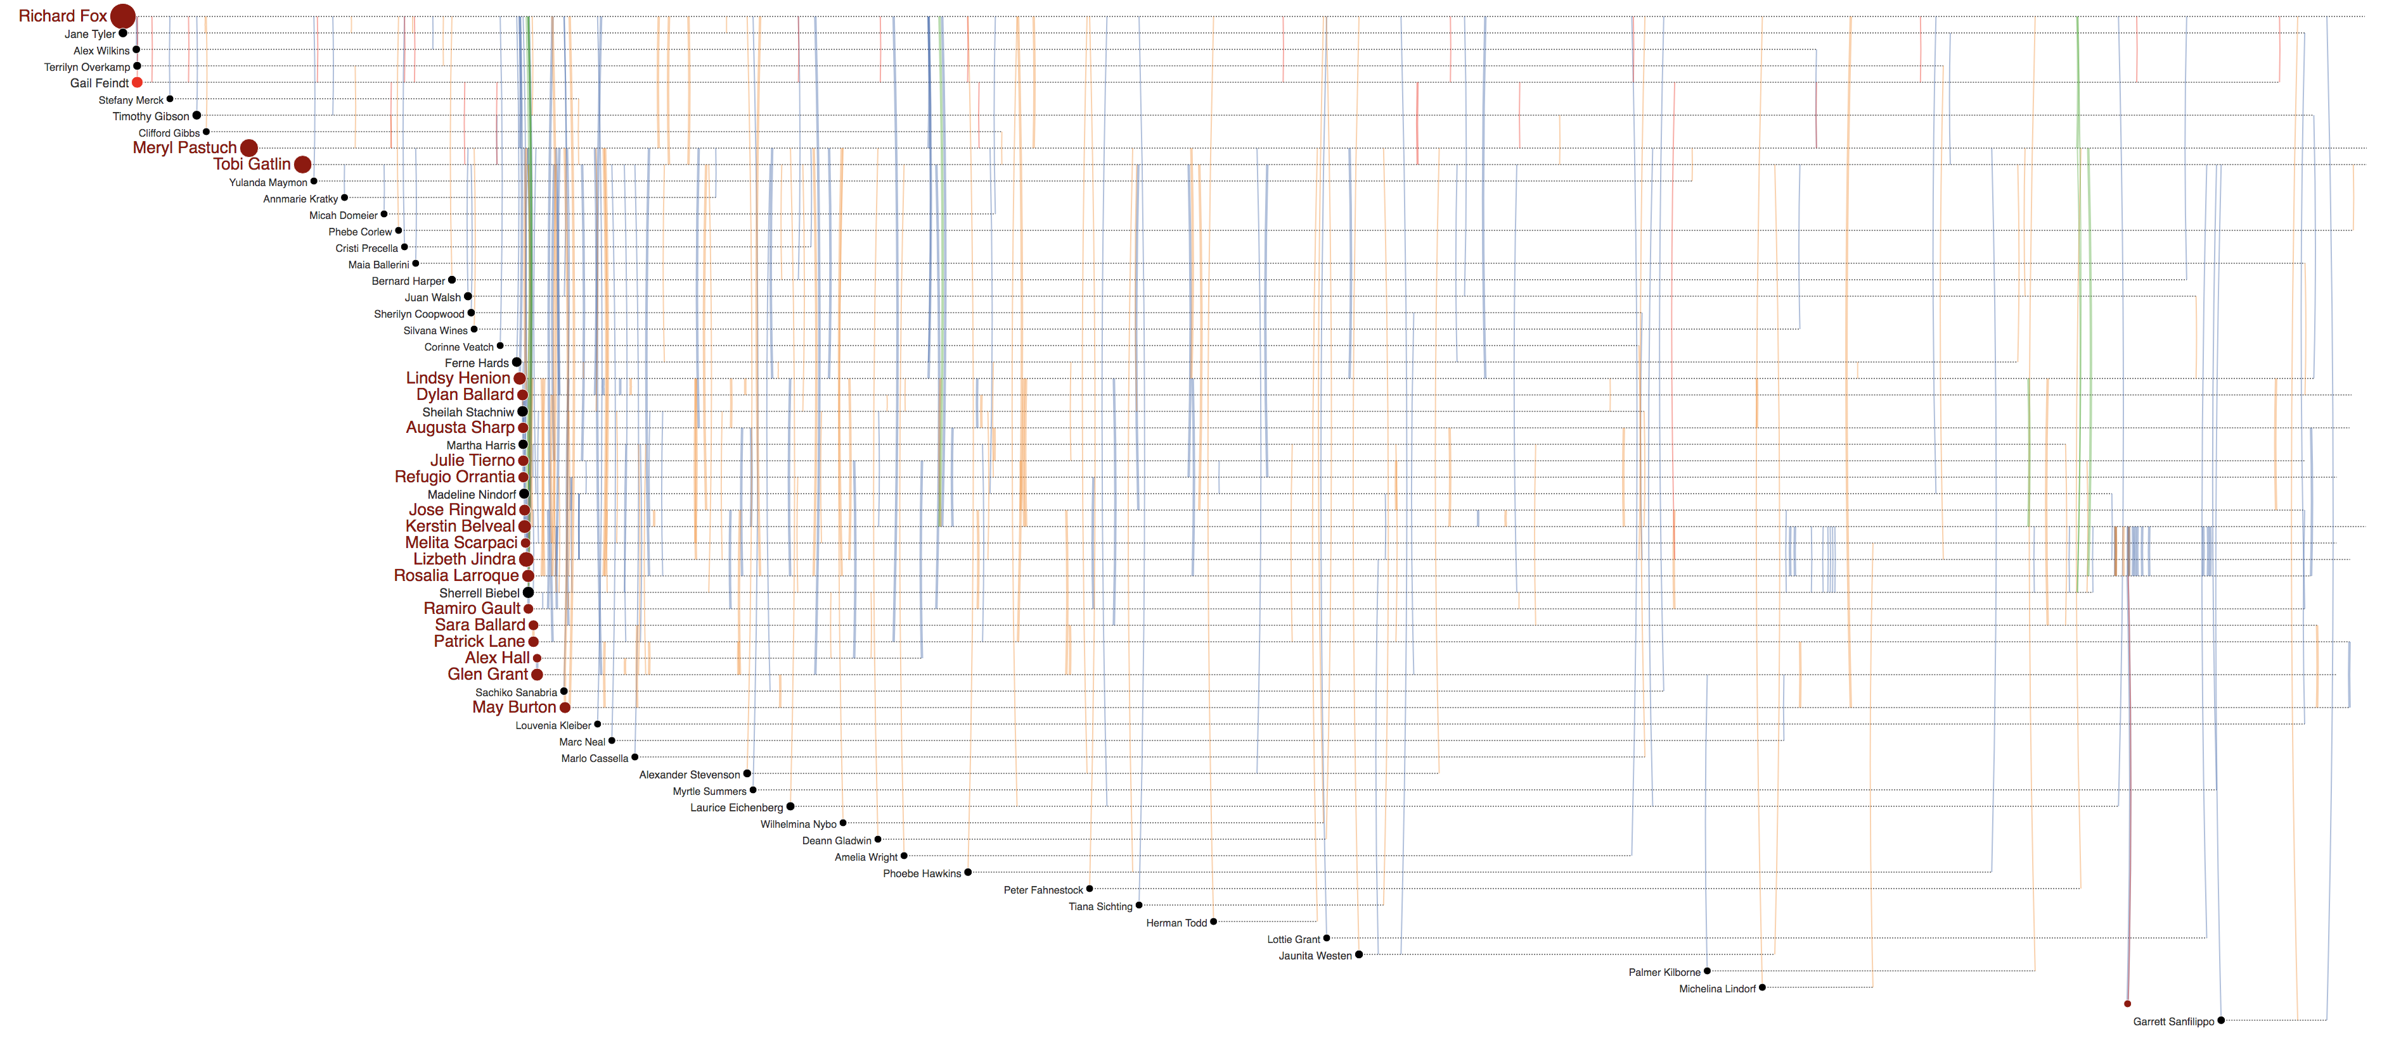
Jenice Savaria
Gail Feindt
(b)
Jenice Savaria
(a)
Jenice Savaria
(c)

Slide 27
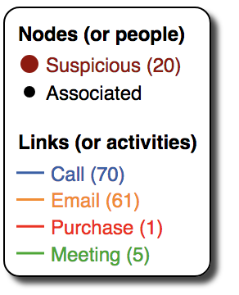
Rosalia Larroque
Rosalia Larroque
Jenice Savaria
(b)
Jenice Savaria
(a)

